Slide 1
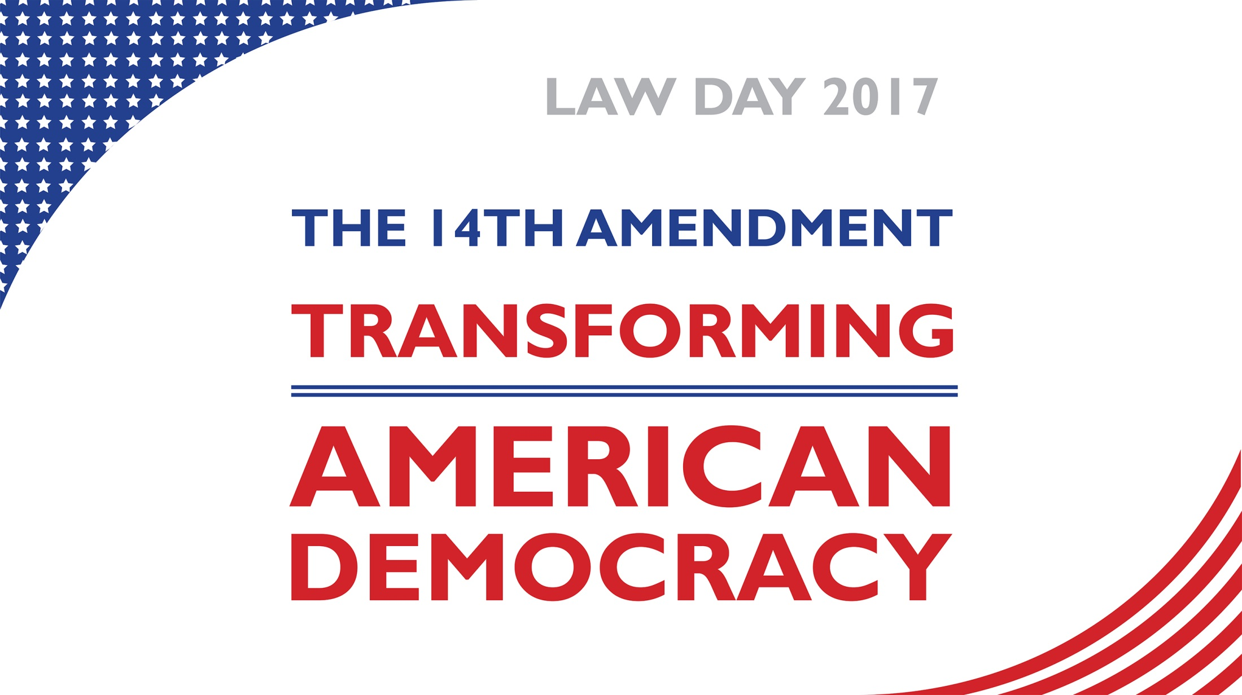


Slide 2
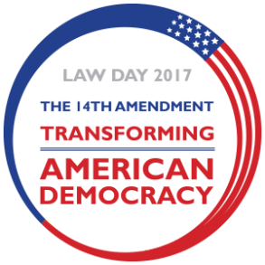
The 14th Amendment
Passed: By Congress on June 13, 1866
Ratified: By the necessary 28 of the 37 States on July 9, 1868
Context: One of Three Post-Civil War Reconstruction Amendments
Goal: To greatly expanded the protection of civil rights to all Americans.
Notes:
The Fourteenth Amendment is one of three Reconstruction Amendments. The Thirteenth Amendment,
abolishing slavery, was ratified in 1865; the Fifteenth Amendment, prohibiting the federal and state governments from
denying citizens the right to vote based on that citizen’s race, color, or previous condition of servitude, was ratified in 1870.

Slide 3
Major Clauses of the 14th Amendment
The Citizenship and the Privileges or Immunities Clauses
All persons born or naturalized in the United States and subject to the jurisdiction thereof, are citizens of the United States and of the States wherein they reside. No State shall make or enforce any law which shall abridge the privileges or immunities of citizens of the United States…
The Due Process Clause
…nor shall any State deprive any person of life, liberty, or property, without due process of law;
The Equal Protection Clause
…nor deny to any person within its jurisdiction the equal protection of the laws.
Notes:
The text of the Fourteenth Amendment is often cited by litigators, civil rights activists, constitutional scholars, and, of course, judges. Here, we take a look at the most cited clauses and offer avenues to explore how they have shaped our constitutional understanding and our everyday experiences. Law Day 2017 gives us a unique opportunity to look at the text of the amendment and explore its origins, evolution, and current application.

Slide 4
The Citizenship and the Privileges or Immunities Clauses
The first sentence of the Amendment generally confers:
Legal citizenship on all persons born in the U.S.; and
States that all citizens (whether natural-born or naturalized), are citizens of both the U.S. and the state in which they live.
The second sentence of Section 1 of the Amendment:
Prohibits states from infringing rights of U.S. citizens.
(narrowly construed)
Notes:
This simple statement transformed a divided nation coming out of the shadow of the
Civil War and a legacy of slavery. The second sentence of Section 1 of the amendment,
the privileges or immunities clause, prohibits states from infringing rights of U.S.
citizens. Since the Slaughter-House Cases of 1873, however, the federal courts have
narrowly interpreted these rights.
Questions to Consider:
• What are the rights and responsibilities of U.S. citizenship?
• Are there different rights for citizens and noncitizens? Should there be?
• How did the Fourteenth Amendment nullify Dred Scott v. Sandford?

Slide 5
The Due Process Clause
The Due Process Clause requires state and local governments to administer fair and just legal proceedings.
Courts have interpreted two aspects of Due Process:
Procedural
Refers to those procedures that guarantee a fair trial before an individual can be deprived of life, liberty, or property, such as the right to a jury, the right to confront witnesses, and the right to a speedy trial.
Substantive
Is a principle allowing courts to protect individuals from government interference of certain rights deemed fundamental, such as the right to privacy and the right to marry.
Notes:
• Due process ensures that individuals are not deprived of their
rights without the benefit of certain fundamental procedural
protections.
• The due process clause of the Fourteenth Amendment is the
source of an array of constitutional rights, including many of
our most cherished.
• Due process includes procedural protections, such as notice
and a hearing before termination of entitlements, for
example, publicly funded medical insurance.
• It protects against state infringement individual rights listed
in the Bill or Rights, including freedom of speech, free
exercise of religion, the right to bear arms, and freedom from
unreasonable searches and seizures.
• It includes fundamental rights that are not specifically
enumerated elsewhere in the U.S. Constitution, including
the right to marry, the right to use contraception, and the
right to abortion.
• The language of the due process clause of the Fourteenth
Amendment echoes that of the Fifth Amendment. The
Fifth Amendment, however, applies only against the federal
government.
Questions to Consider:
• What are the key aspects of due process? What makes a legal proceeding fair?
• How can we ensure due process for criminal defendants when courts are underfunded and overburdened?
• What is the difference between substantive and procedural due process?
• How does the Fourteenth Amendment’s guarantee of due process differ from that of the Fifth Amendment?

Slide 6
The Equal Protection Clause
The Equal Protection Clause prohibits states from discriminating against individuals or groups and advances constitutional equality.
Courts apply a strict level of scrutiny to laws that:
Classify by race, national origin, and religion; and
Laws that impact fundamental rights such as interstate migration, voting, and access
Notes:
• In the landmark 1954 Supreme Court ruling Brown v. Board
of Education, that applied the Fourteenth Amendment’s
equal protection clause, Chief Justice Earl Warren famously
wrote, “We conclude that in the field of public education
the doctrine of ‘separate but equal’ has no place. Separate
educational facilities are inherently unequal.”
• Congress enacted federal educational and employment antidiscrimination
laws to fulfill the promise of “equal protection
of law” enshrined in the Fourteenth Amendment.
• Affirmative action programs have helped to reduce, but not
eliminate, racial disparities in the number of degrees awarded
by higher education institutions.
• In 2015, about 47% of whites had at least a two year college
degree. By comparison, about 33% of African American
adults had at least a two year college degree, up from 28% in
2007. For Hispanics, that figure grew from 19% to 23% over
the same period from 2007 to 2015.3
• Despite passage of the Equal Pay Act of 1963, which requires
that men and women in the same work place be given
equal pay for equal work, the “gender gap” in pay persists.
In 2014, a woman working full-time all year in the United
States earned 79% of what a man earned in a year. Phrased
differently, she earned 79 cents for every dollar that he
earned.
• The pay gap is even greater for African American and Latina
women, with African American women earning 64 cents and
Latina women earning 56 cents for every dollar earned by a
white non-Hispanic man.
Questions to Consider:
• How did the Fourteenth Amendment change our understanding of equality?
• What role did the clause play in the Supreme Court’s decision in Brown v. Board of Education and subsequent landmark civil rights cases?
• Should the idea of human dignity be a part of equal protection law?

Slide 7
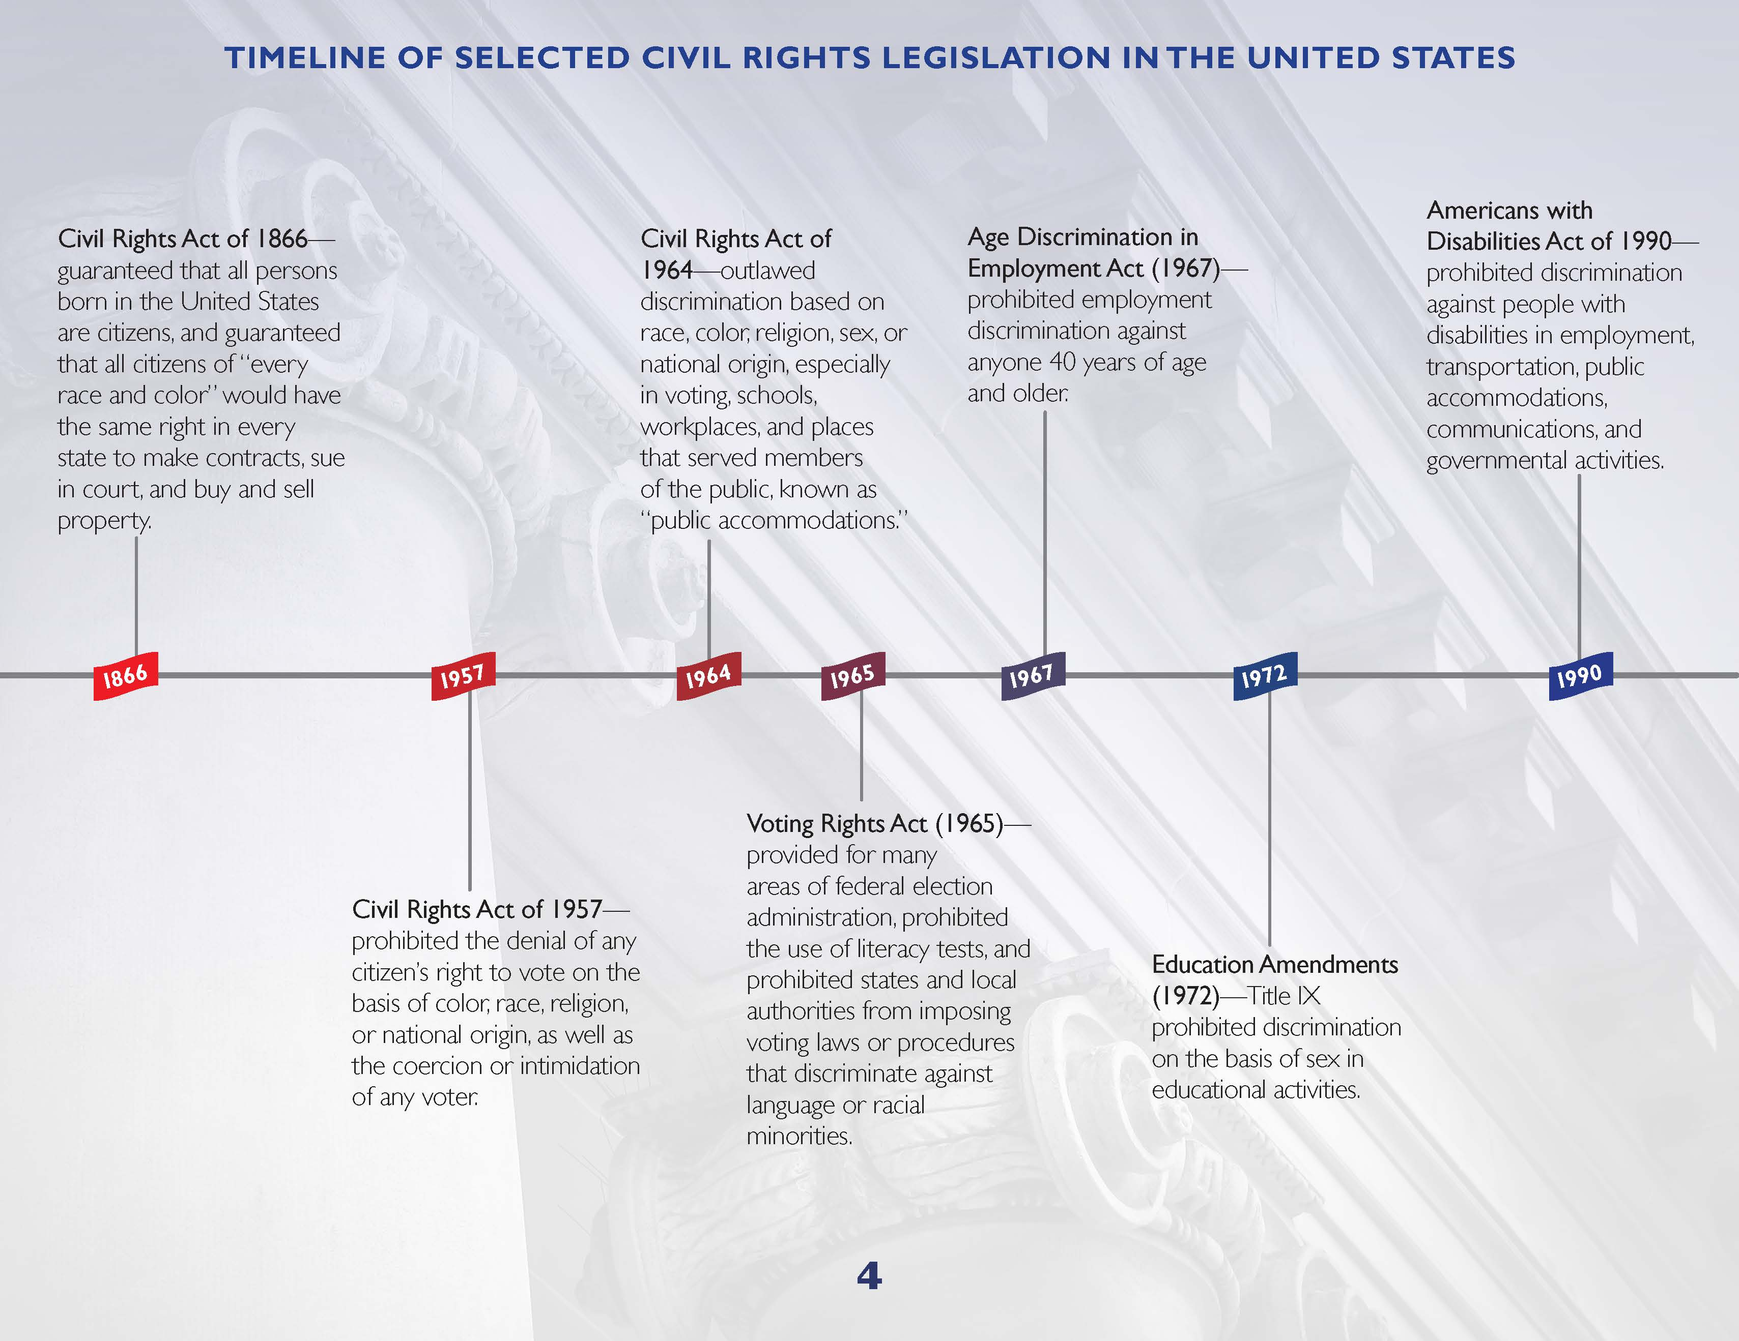
Notes:
• In the landmark 1954 Supreme Court ruling Brown v. Board
of Education, that applied the Fourteenth Amendment’s
equal protection clause, Chief Justice Earl Warren famously
wrote, “We conclude that in the field of public education
the doctrine of ‘separate but equal’ has no place. Separate
educational facilities are inherently unequal.”
• Congress enacted federal educational and employment antidiscrimination
laws to fulfill the promise of “equal protection
of law” enshrined in the Fourteenth Amendment.
• Affirmative action programs have helped to reduce, but not
eliminate, racial disparities in the number of degrees awarded
by higher education institutions.
• In 2015, about 47% of whites had at least a two year college
degree. By comparison, about 33% of African American
adults had at least a two year college degree, up from 28% in
2007. For Hispanics, that figure grew from 19% to 23% over
the same period from 2007 to 2015.3
• Despite passage of the Equal Pay Act of 1963, which requires
that men and women in the same work place be given
equal pay for equal work, the “gender gap” in pay persists.
In 2014, a woman working full-time all year in the United
States earned 79% of what a man earned in a year. Phrased
differently, she earned 79 cents for every dollar that he
earned.
• The pay gap is even greater for African American and Latina
women, with African American women earning 64 cents and
Latina women earning 56 cents for every dollar earned by a
white non-Hispanic man.
Questions to Consider:
• How did the Fourteenth Amendment change our understanding of equality?
• What role did the clause play in the Supreme Court’s decision in Brown v. Board of Education and subsequent landmark civil rights cases?
• Should the idea of human dignity be a part of equal protection law?

Slide 8
Doctrine of Incorporation
Originally, courts held that the first ten amendments of the Constitution, only applied to the Federal Government.
During the late 18 and 1900s the Supreme Court changed its stance and held that the following rights are enforceable against both state and local governments:
freedom of speech & religion | right against cruel & unusual punishment | right to counsel & to a jury trial
right to bear arms & against being forced to quarter soldiers | freedom from unreasonable searches & seizures | right against self-incrimination
Notes:
With the incorporation doctrine, recognized by the courts starting in the late 19th
century, most provisions of the Bill of Rights have been found
to apply not only to the federal government, but also to state
and local governments. Under the incorporation doctrine, most
provisions of the Bill of Rights now also apply to state and local
governments.
1833 in the case of Barron v. Baltimore, the Supreme Court ruled that
first ten amendments did not apply to states, only to the federal government.
• Ohio Congressman John Bingham, drafter of the principle
language of the Fourteenth Amendment, observed,
“Privileges and immunities of citizens of the United States …
are chiefly defined in the first eight amendments to the
Constitution of the United States...These eight articles…
never were limitations upon the power of the states until
made so by the Fourteenth Amendment.”
• Over the years, the Supreme Court has granted corporations,
by virtue of their legal status of personhood, most of the
constitutional rights possessed by natural persons, including
the due process right in the Fourteenth Amendment. For
example, the U.S. Supreme Court has ruled that an excessive
fine against a corporation violates its Fourteenth Amendment
rights.

Slide 9
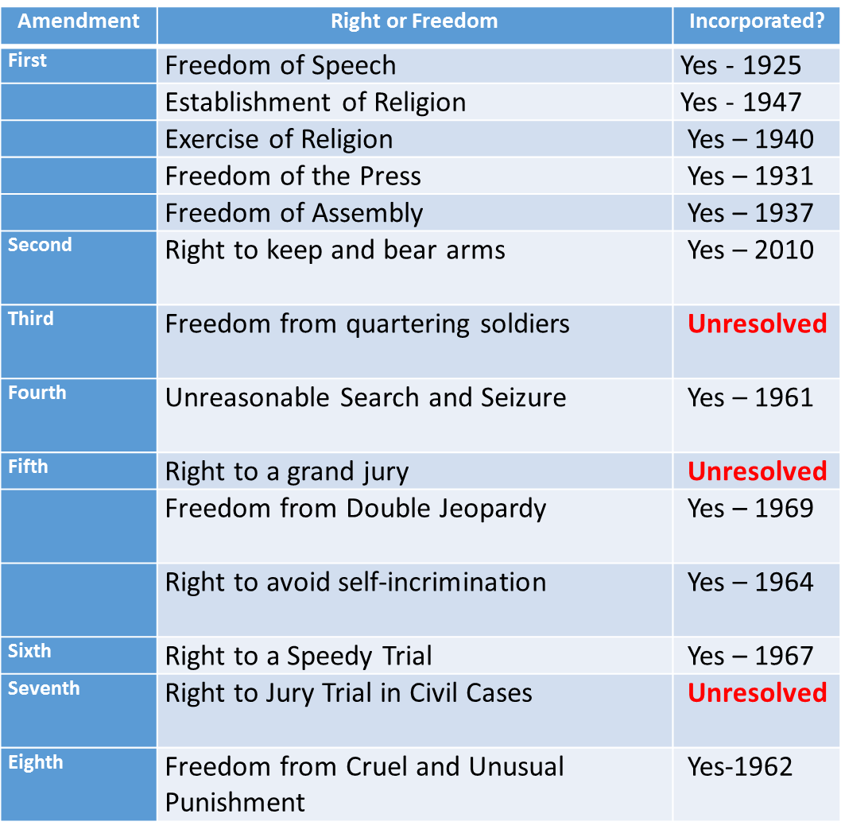
Doctrine of Incorporation
Bill of Rights
Notes:
With the incorporation doctrine, recognized by the courts starting in the late 19th
century, most provisions of the Bill of Rights have been found
to apply not only to the federal government, but also to state
and local governments. Under the incorporation doctrine, most
provisions of the Bill of Rights now also apply to state and local
governments.
1833 in the case of Barron v. Baltimore, the Supreme Court ruled that
first ten amendments did not apply to states, only to the federal government.
• Ohio Congressman John Bingham, drafter of the principle
language of the Fourteenth Amendment, observed,
“Privileges and immunities of citizens of the United States …
are chiefly defined in the first eight amendments to the
Constitution of the United States...These eight articles…
never were limitations upon the power of the states until
made so by the Fourteenth Amendment.”
• Over the years, the Supreme Court has granted corporations,
by virtue of their legal status of personhood, most of the
constitutional rights possessed by natural persons, including
the due process right in the Fourteenth Amendment. For
example, the U.S. Supreme Court has ruled that an excessive
fine against a corporation violates its Fourteenth Amendment
rights.

Slide 10

For more information visit the Justice for All website:
http://justiceforall.ca2.uscourts.gov/

